Slide 1
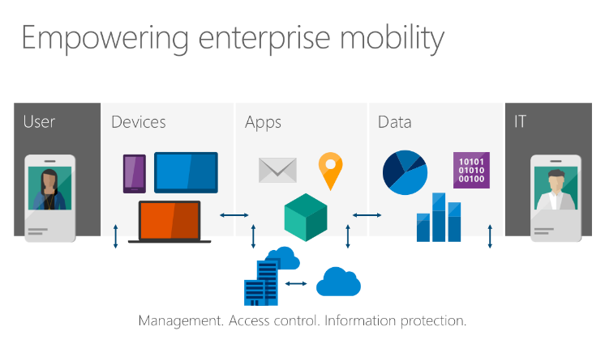
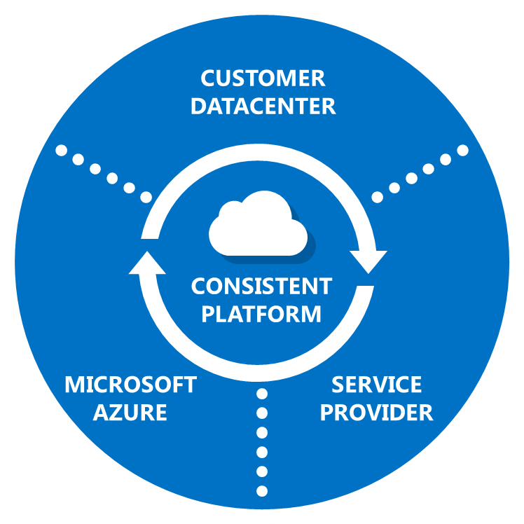

Empower enterprise mobility
Mobility is the new normal
People-centric IT
How people work has changed significantly. New form factors, apps, and working practices all play a role in the shift towards enterprise mobility. Enterprise mobility from Microsoft provides a complete solution that encompasses user, device, application, and data management. A people-centric approach builds on existing investments and skills and offers a credible one-vendor solution to customers looking to rationalize their environment. With strong capabilities to manage user identity, devices, and data protection you can address three constant business requirements: empowering users, protecting data, and controlling costs and resources.
Hybrid identity
Mobile device & application management
Access & information protection
Desktop Virtualization
Empower users with self-service and consistent single sign-on experiences.
Give users access to workplace assets from almost any device while ensuring compliance.
Centralize data, classify information, and control access to the datacenter.
Provide a full and rich Windows experience across user devices.
Getting started
Empower enterprise mobility to:
Empower your users
Help IT protect your data
Unify your environment
Get started today by visiting: www.microsoft.com/enterprisemobility

